Slide 1
Blockchain App in a Day Workshop Presenters Companies

Slide 2
Blockchain Positioning and Strategy
Understand roles for blockchain and Microsoft strategy
Discuss use cases across industries

Slide 3
Building an end-to-end blockchain app is a huge undertaking
Link to federated identity systems
Integrate with existing business apps
Configure consortium network
Ingest messages and events
Manually deploy
ledger
Synchronize data with off-chain DB
Write business logic
Extend capabilities
Orchestrate signing, hashing and routing
Customize integrations
Store smart contract reference data
API
management
Manage keys
Build web client

Slide 4
So we’ve taken steps to create a platform that would tackle those challenges
1
2
3
Populated preconfigured networks
Integrated relevant cloud services
Built a simple interface

Slide 5

We’ve seen this pattern in scenarios across industries
Banking and Capital Markets
Manufacturing
Retail
Insurance
Government
Health
Asset tracking
Real-time auction for supplier contracts
Supply chain transparency
Dynamic commodities pricing
Loyalty tracking
Product provenance
Logistics management
Digital rewards
P2P selling
Ticket purchases
Claims management
MBS/Property payments
Fraud detection
Automated underwriting
Audit compliance
Bond issuance
Trade finance
Loan syndication
Post trade settlement
Global payments
Derivatives trading
KYC/AML
Licensing and ID
Land registry
Benefits distribution
Aid tracking
Military security
Voting
Copyrights
Justice system administration
Personalized medicine
Records sharing
Compliance
Pharmaceutical provenance
Asset transfer and provenance
Cross-organizational workflow
Multiparty auditing

Slide 6






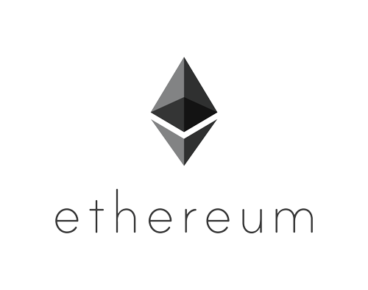




With Azure Blockchain Workbench you can skip the scaffolding
Workflow execution
Identity & key management
Ledger-neutral approach
Auto-generate starter apps
Integration APIs & events
Workflow/user admin
Azure data integration
Horizontal SaaS & adapters
Client apps & devices
Azure Blockchain Workbench
Identity & Key Management
Enterprise Integration
Data
Platform
(ML/BI)
Off-Chain Storage
Monitoring & Security
3rd Party
Services
Enterprise ledger

Slide 7


With an enterprise-ready, customizable approach
Consuming Apps, Services & Systems
Data Sources
Power BI
DLT Services (API, Hashing, Signing)
Blockchain Ledger
APIs
API
Service Bus
Off-Chain DB
Apps
Logic Apps
Off-Chain Storage
Event Grid
Sensor Data
Azure Functions
Reference Data
Azure AD
Azure Key Vault
Application Insights
Virtual Networking

Slide 8
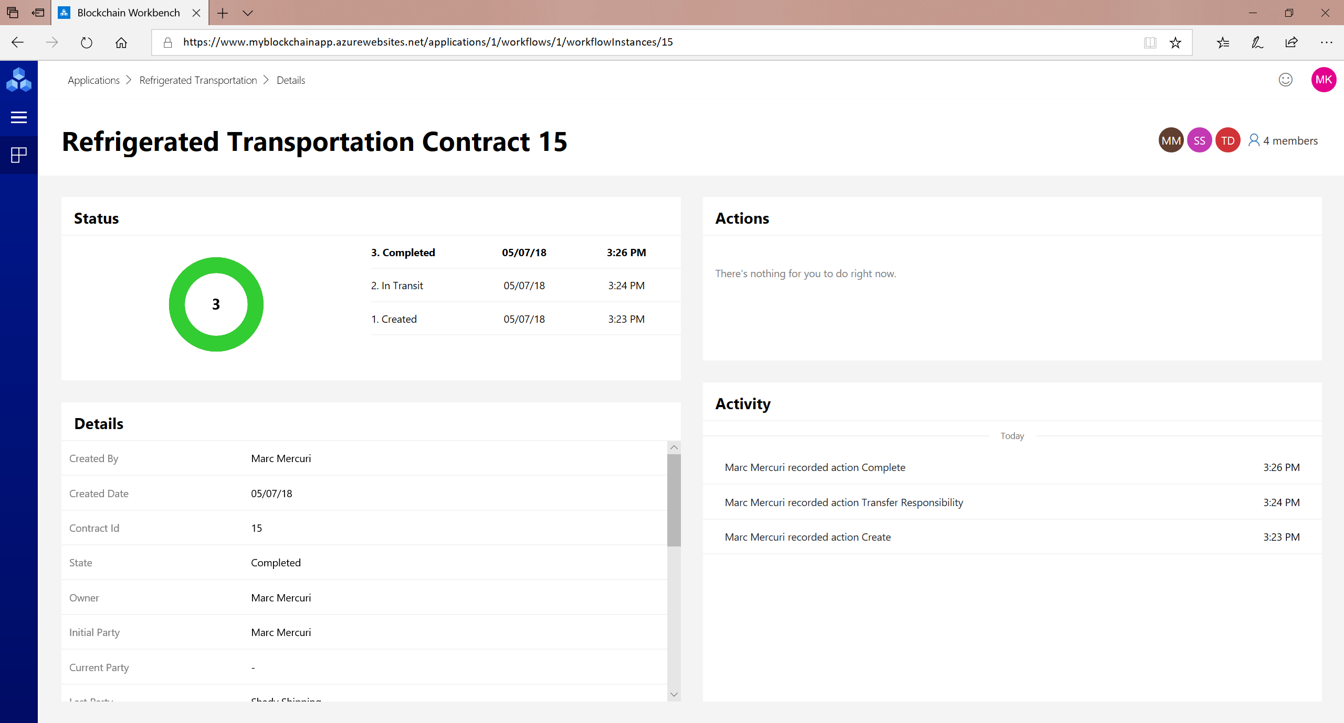
Now, we’ve built a simple interface for deploying these services and interacting with smart contracts

Slide 9
Workbench lets you focus your time on adding value for your business
Link to federated identity systems
Integrate with existing business apps
Configure consortium network
Ingest messages and events
Manually deploy
ledger
Synchronize data with off-chain DB
Write business logic
Extend capabilities
Orchestrate signing, hashing and routing
Customize integrations
Store smart contract reference data
API
management
Manage keys
Build web client

Slide 10
Azure Blockchain Workbench Solution Review
Demonstrate and review a completed Azure Blockchain Workbench solution
Asset Transfer Application demonstration

Slide 11
Azure Blockchain Workbench, Sample Solution, Code Walkthrough
Azure Blockchain Workbench architecture
Deploy sample solution
Hands-on walkthrough of Solidity code and Azure Blockchain Workbench solution configuration

Slide 12
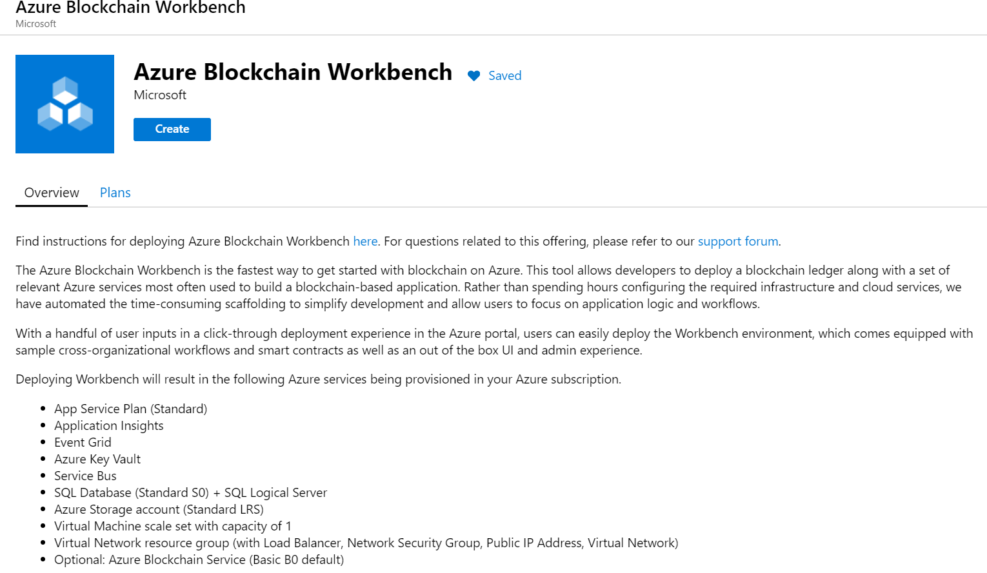
Azure Blockchain Workbench Architecture
Rapid Prototyping for Blockchain Applications
Azure Blockchain Workbench is the fastest way to get started with blockchain on Azure. This tool allows developers to deploy a blockchain ledger along with a set of relevant Azure services most often used to build a blockchain-based application. Rather than spending hours configuring the required infrastructure and cloud services, we have automated the time-consuming scaffolding to simplify development and allow users to focus on application logic and workflows.

Slide 13
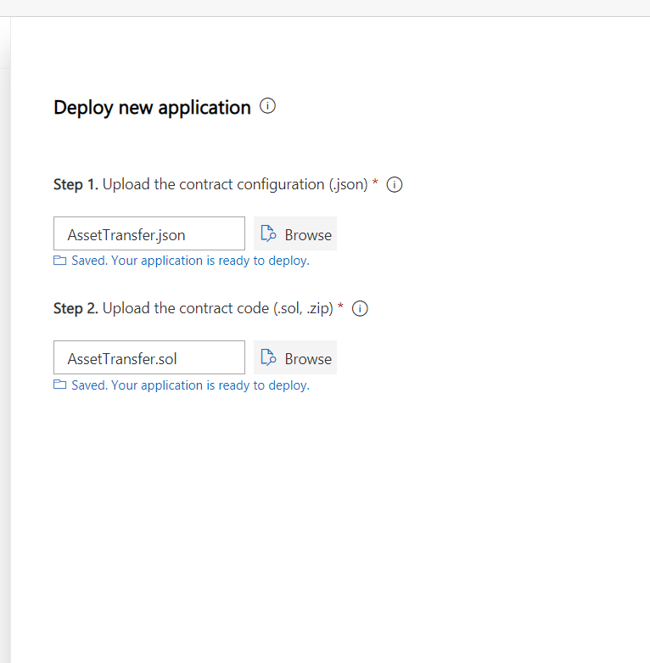
Deploy sample solution
Deploy the Asset Transfer Sample
The Asset Transfer sample blockchain application is included in the workshop GitHub repository under the code folder.
From your Azure Blockchain Workbench portal, you'll create a New Application by uploading the Asset Transfer .json and .sol files to Azure Blockchain Workbench.
Using either the portal or PowerShell, you'll create users for the Asset Transfer roles in your application Azure Active Directory namespace created prior to the workshop. You'll then assign these users to the required roles.

Slide 14
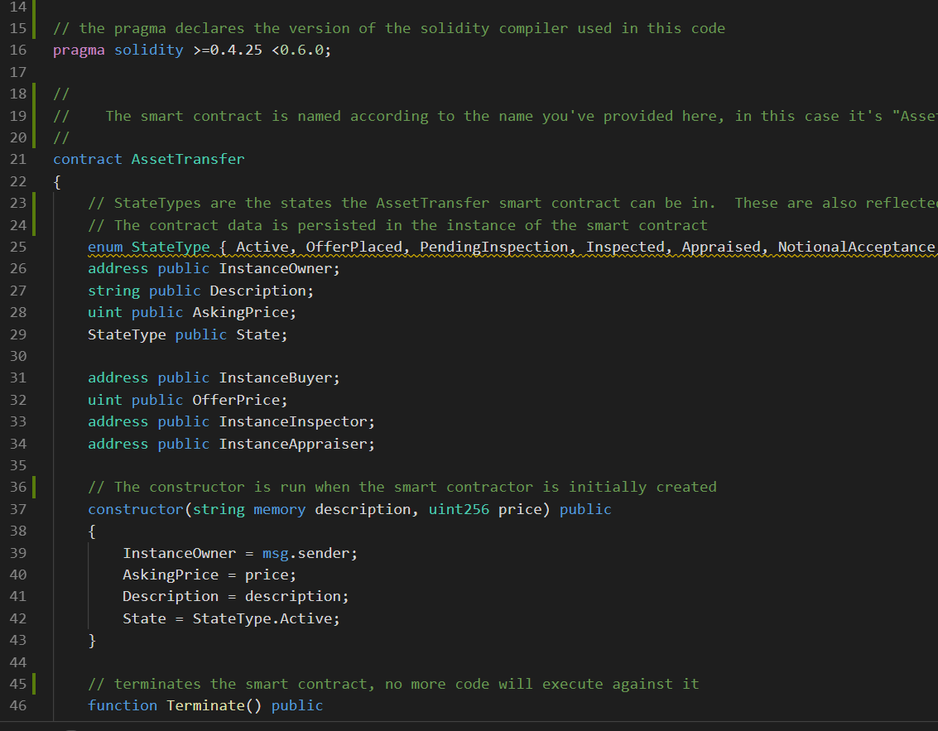
Code and Solution Configuration Walkthrough
Code and Solution Configuration
The blockchain code is written in Solidity using Visual Studio Code – you should have completed the setup prerequisites prior to the workshop.
Azure Blockchain Workbench enables extending the solution for events, IoT, data analysis, logic apps, etc. Understanding the configuration of these services and extensibility model is imperative to create MVPs for the enterprise.

Slide 15
MVP - Solution Development and Deployment
Create an application story
Define application roles, states, workflow, and data elements
Code Solidity and JSON smart contract application files
Deploy Solidity and JSON files using Workbench
Create Azure AD users, add members as application users
Test application

Slide 16
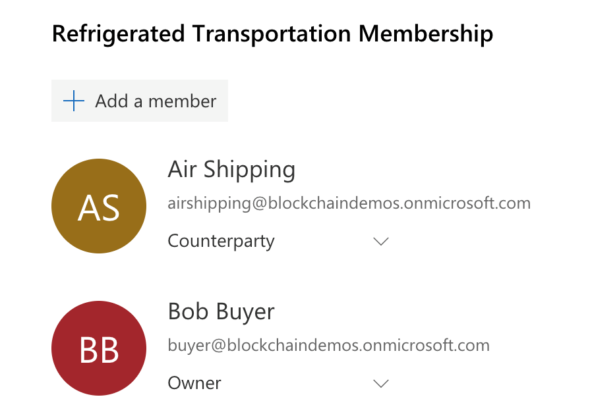
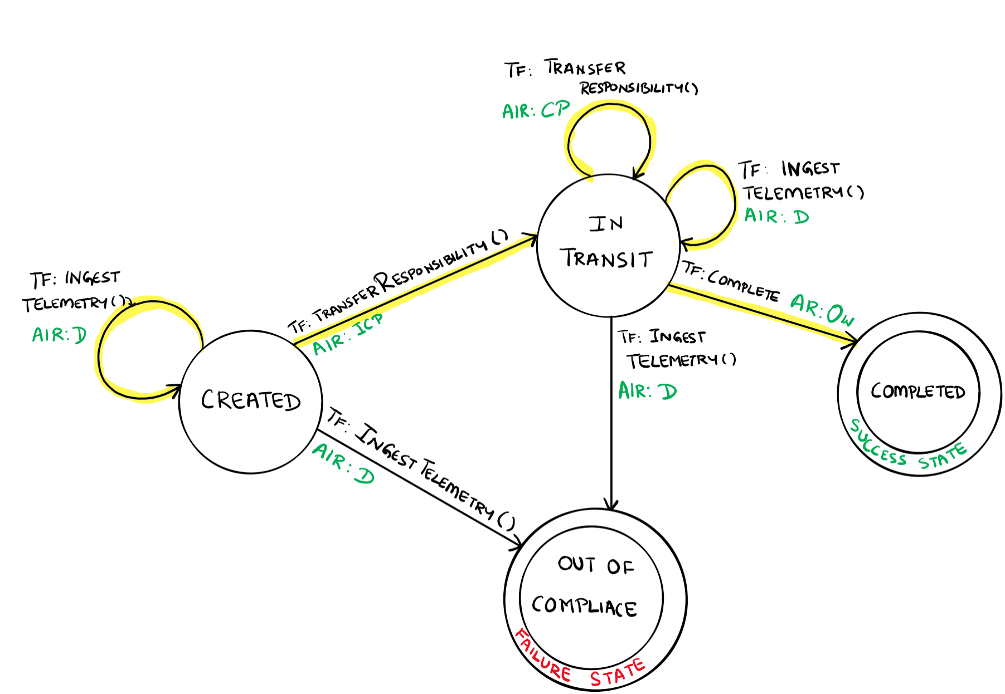
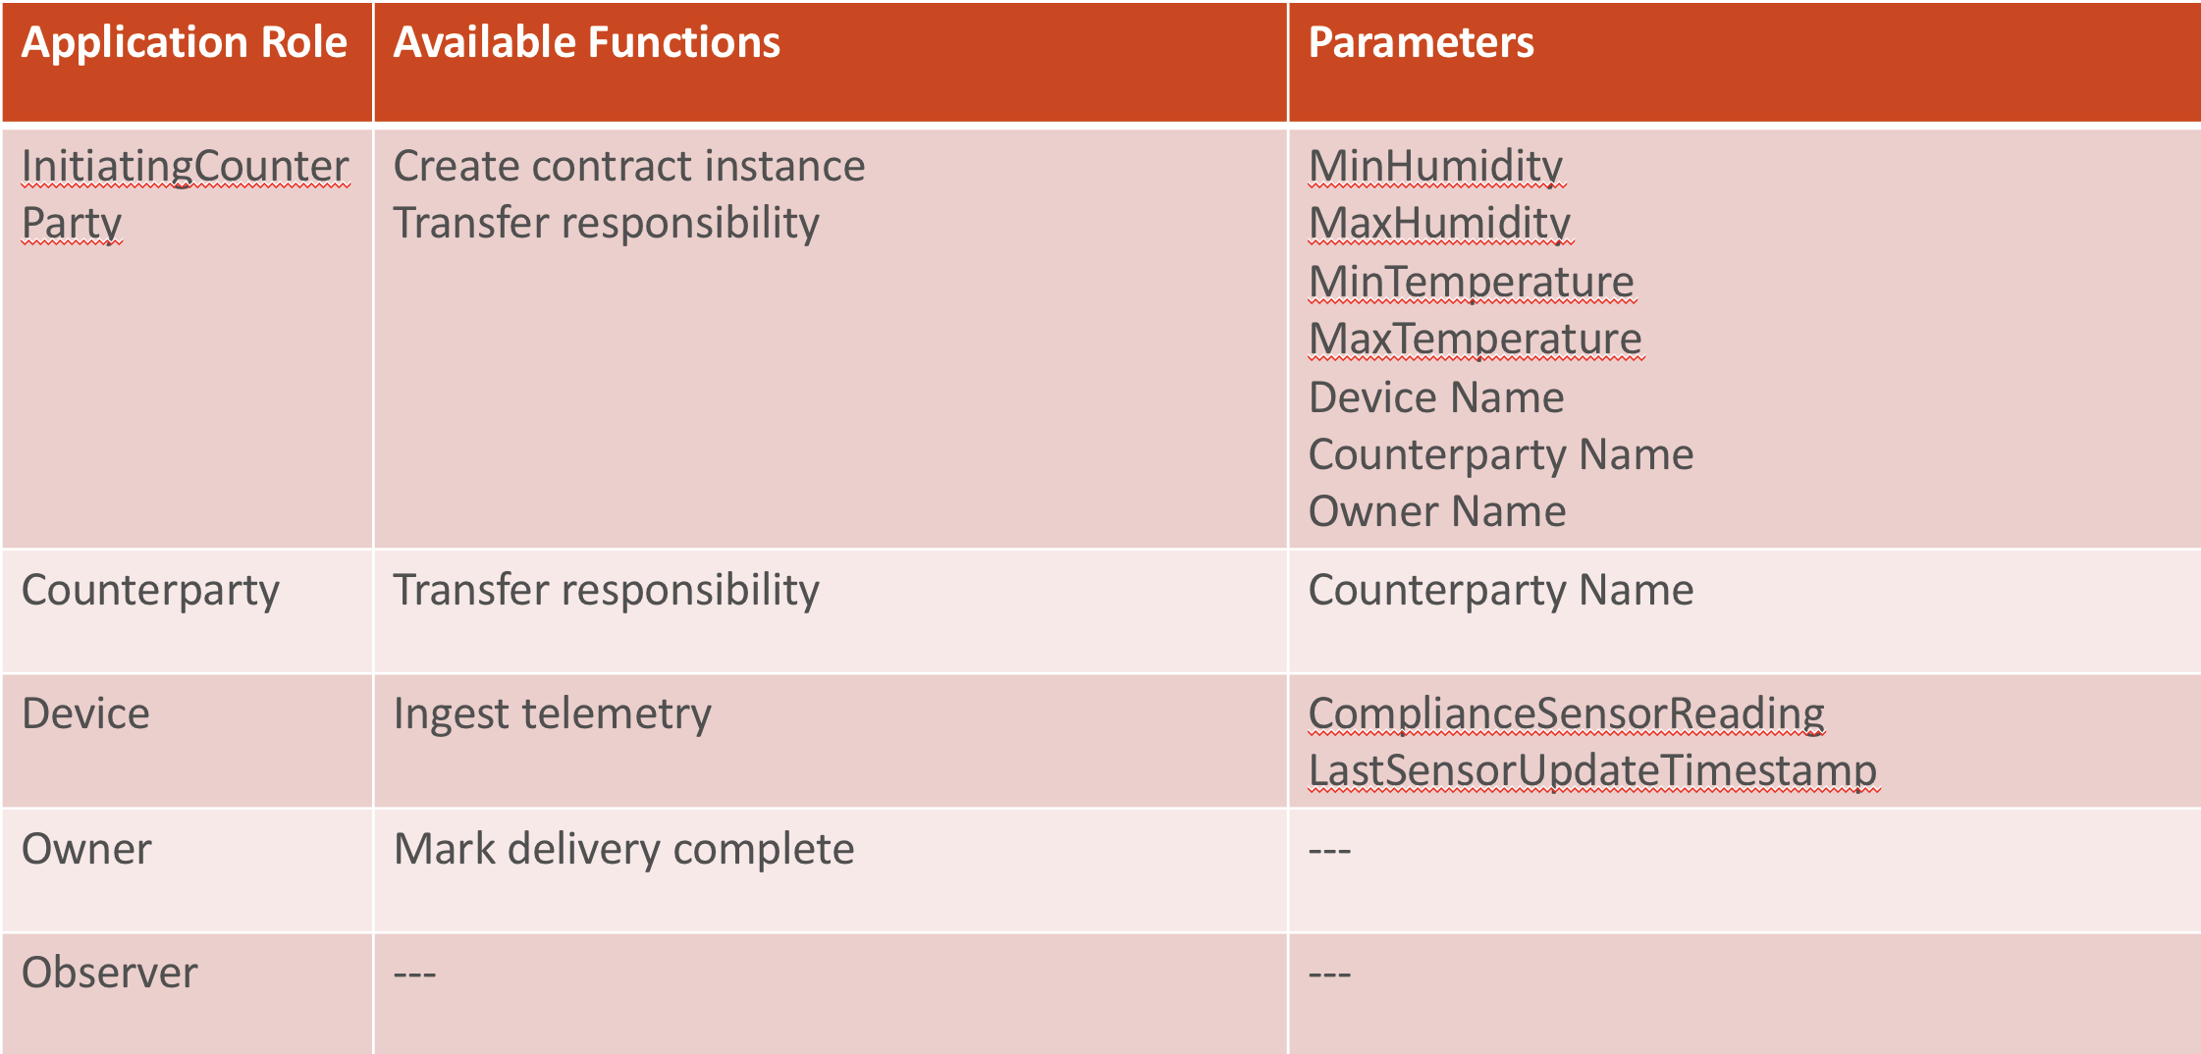
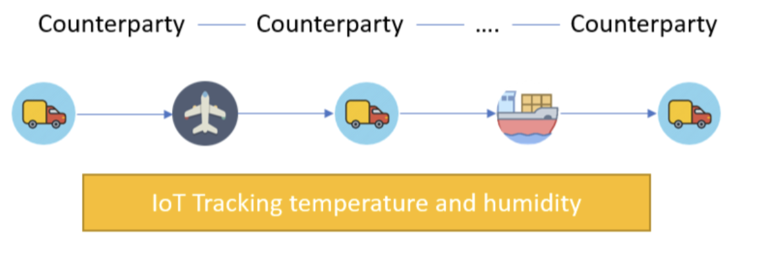
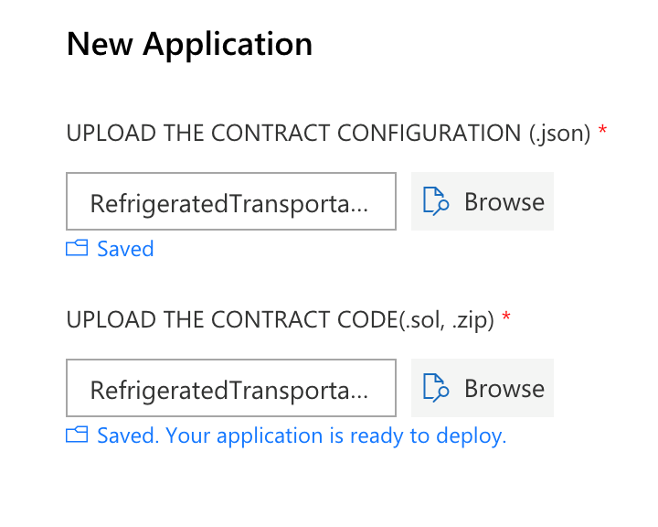
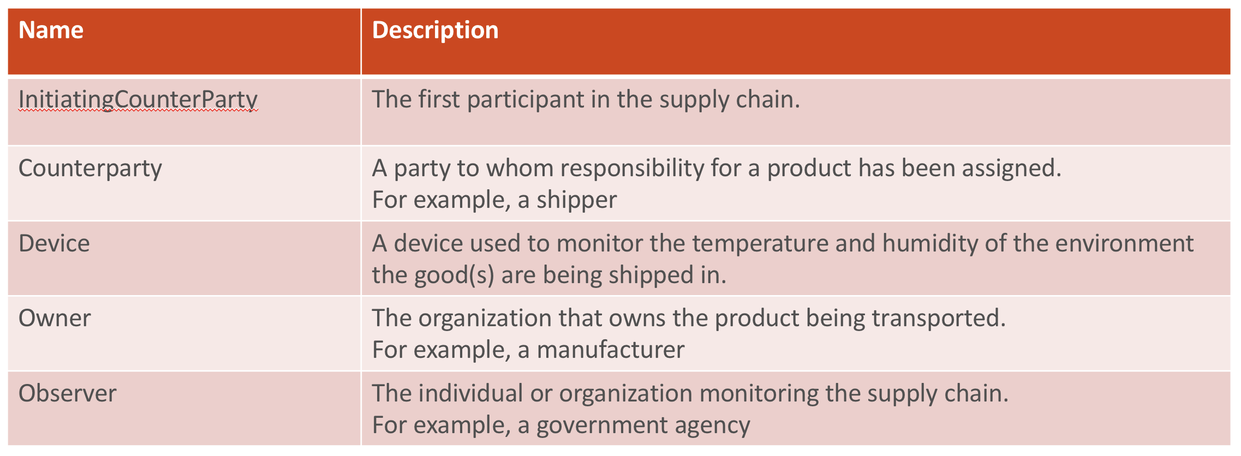
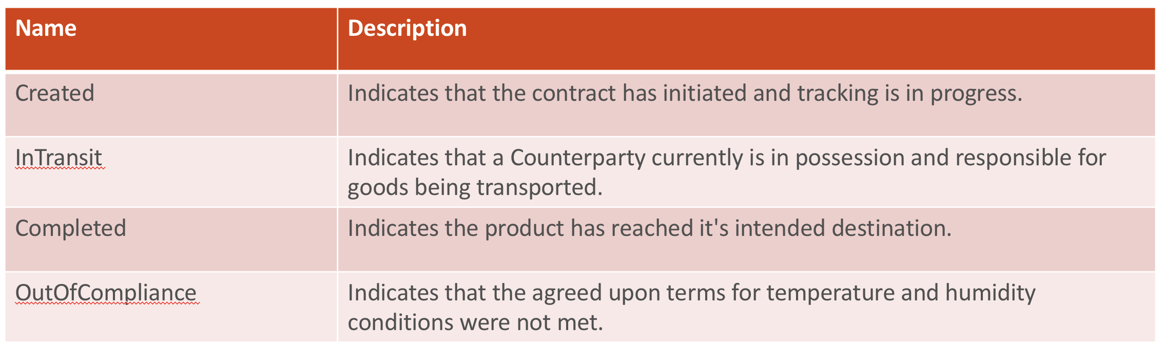
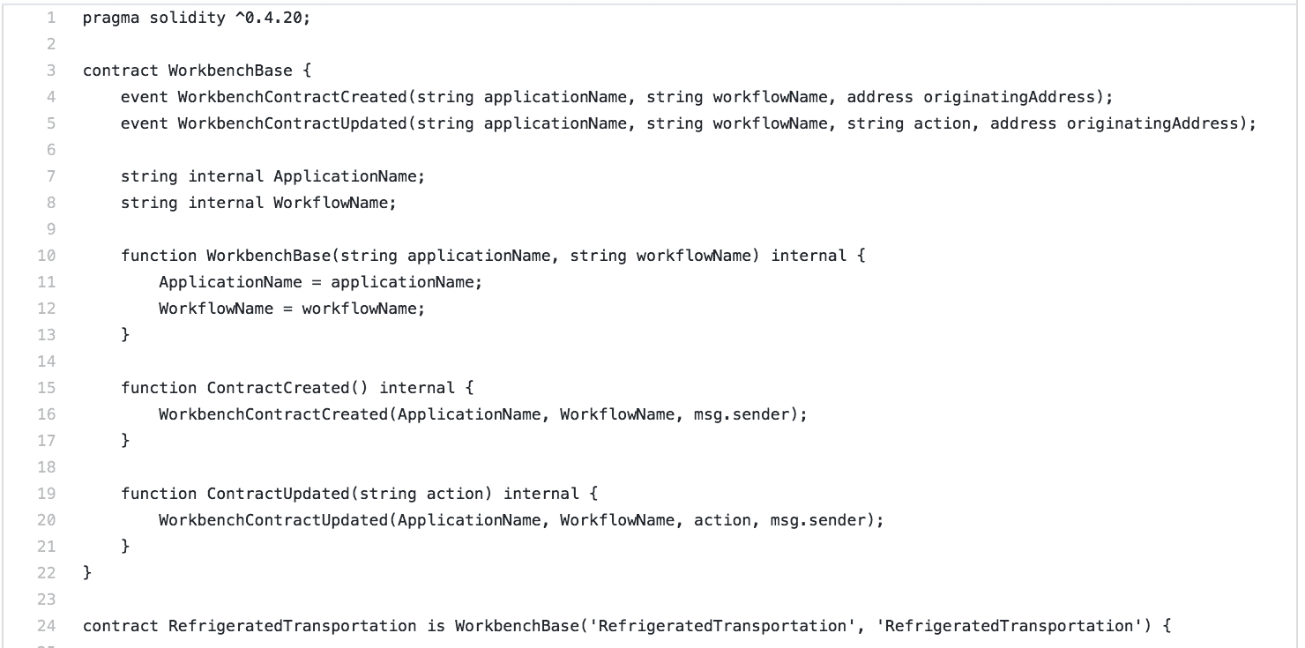
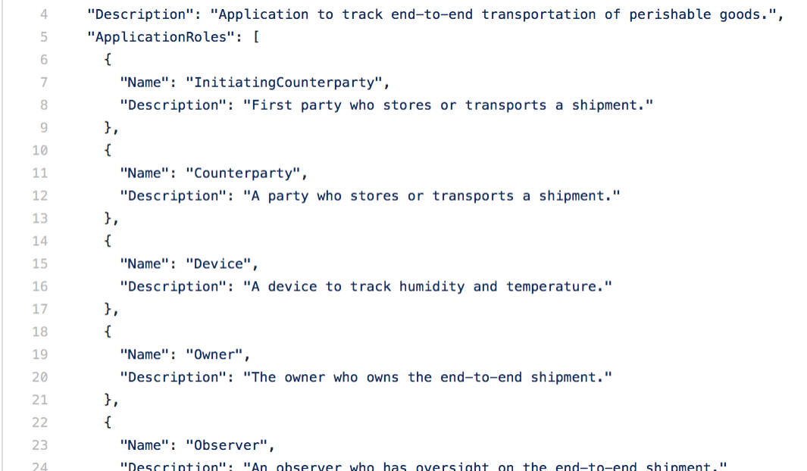
Blockchain App in a Day - Process Flow
Step 9 | Add Users and Test
Step 1 | Create Story
Step 4 | Draft Workflow
Step 5 | Specify On-Chain Data
Step 8 | Deploy App
Step 3 | Define Smart
Contract States
Step 2 | Define App Roles
Step 6 | Code Smart Contract
Step 7 | Code Config

Slide 17
Create your application story
Start with a Scenario Overview
The refrigerated transportation smart contract covers a provenance scenario with IoT monitoring. You can think of it as a supply chain transport scenario where certain compliance rules must be met throughout the duration of the transportation process. The initiating counterparty specifies the humidity and temperature range the measurement must fall in to be compliant. At any point, if the device takes a temperature or humidity measurement that is out of range, the contract state will be updated to indicate that it is out of compliance.
Illustrate the desired process flow

Slide 18
Define your application roles
Name | Description
InitiatingCounterParty | The first participant in the supply chain.
Counterparty | A party to whom responsibility for a product has been assigned. For example, a shipper
Device | A device used to monitor the temperature and humidity of the environment the good(s) are being shipped in.
Owner | The organization that owns the product being transported. For example, a manufacturer
Observer | The individual or organization monitoring the supply chain. For example, a government agency
All participants can view the state and details of the contract at any point in time. The counterparty doing the transportation will specify the next counterparty responsible, and the device will ingest temperature and humidity data which gets written to the chain. This allows the Supply Chain Owner and Supply Chain Observer to pinpoint which counterparty did not fulfill the compliance regulations if at any point in the process either the temperature or humidity requirements were not met.

Slide 19
Enumerate all of your smart contract states
Name | Description
Created | Indicates that the contract has initiated and tracking is in progress.
InTransit | Indicates that a Counterparty currently is in possession and responsible for goods being transported.
Completed | Indicates the product has reached it's intended destination.
OutOfCompliance | Indicates that the agreed upon terms for temperature and humidity conditions were not met.
Combine the application story, roles and smart contract states to create a state transition design that articulates the possible flows, and the various transition functions at each state. Each user is only allowed to take certain actions depending on the application role. Instance roles indicate that only the user with the application role assigned to the specific contract is able to take actions on the contract.

Slide 20
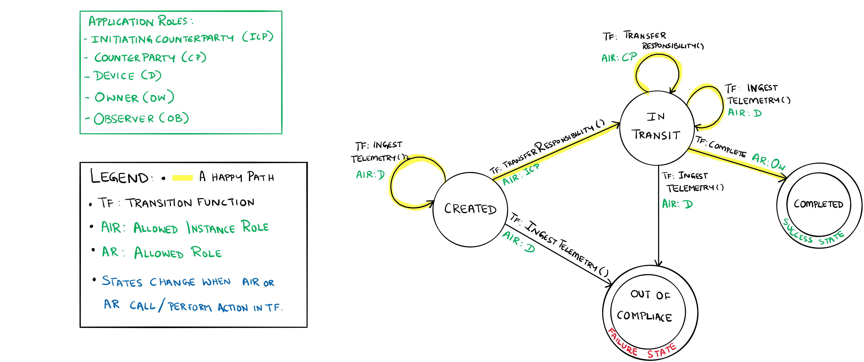
Draft the workflow details as a state transition design
MVP - Solution Development and Deployment​
This contract demonstrates how to collect telemetry information and enforce contract specifics related to conditions during transport. Specifically, receiving and evaluating temperature and humidity data against an agreed upon acceptable range. If the IoT device identifies that the telemetry is out of the acceptable range, the contract will shift into an out of compliance state and appropriate remedies can be sought. In the highlighted happy path, the device ingests readings, which are in compliance throughout the transportation process, while the involved counterparties transfer responsibility until the transportation is completed.

Slide 21
Specify data as parameters relative to roles and functions
Application Role | Available Functions | Parameters
InitiatingCounterParty | Create contract instance Transfer responsibility | MinHumidity MaxHumidity MinTemperature MaxTemperature Device Name Counterparty Name Owner Name
Counterparty | Transfer responsibility | Counterparty Name
Device | Ingest telemetry | ComplianceSensorReading LastSensorUpdateTimestamp
Owner | Mark delivery complete | ---
Observer | --- | ---
Use the workflow details to inform your decisions for a minimum viable set of parameters to store on your distributed ledger.

Slide 22
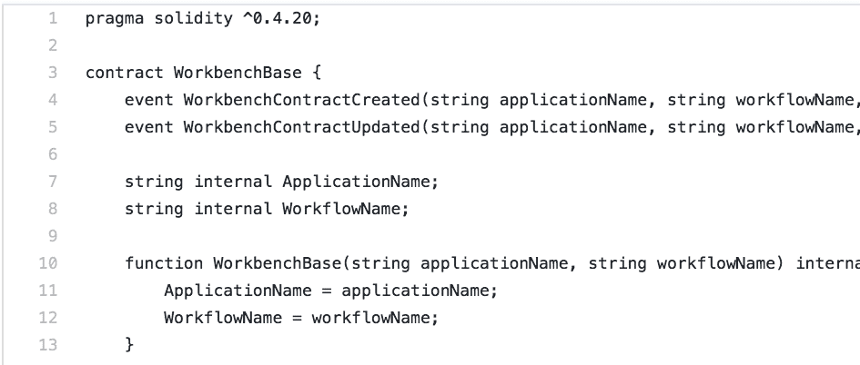
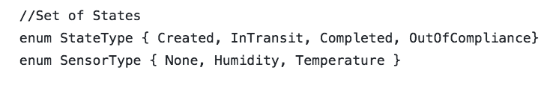
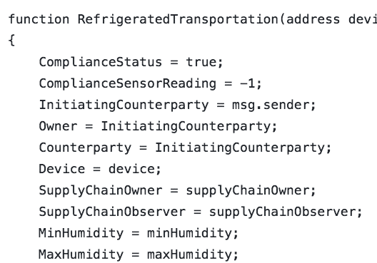
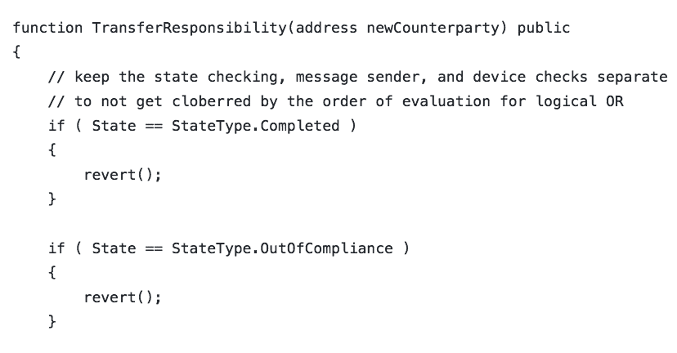
Prepare to write your workflow details as a Solidity Smart Contract
Workbench uses both the configuration file and smart contract code file to create a blockchain application. There is a relationship between what is defined in the configuration and the code in the smart contract.
Contract
State Variables
State variables store values of the state for each contract instance
Constructor
The constructor defines input parameters for a new smart contract instance of a workflow
Functions
Functions are the executable units of business logic within a contract
Pass the application name and the workflow name as arguments
1:1 relationship between contracts and config files
Name matching required
The state variables in your contract must match the workflow properties defined in the configuration file
The constructor is declared as a function with the same name as the contract
Required parameters for the constructor are defined as constructor parameters in the configuration file
The number, order, and type of parameters must match in both files.
Required parameters for the function are defined as function parameters in the configuration file
The number, order, and type of parameters must match in both files.

Slide 23
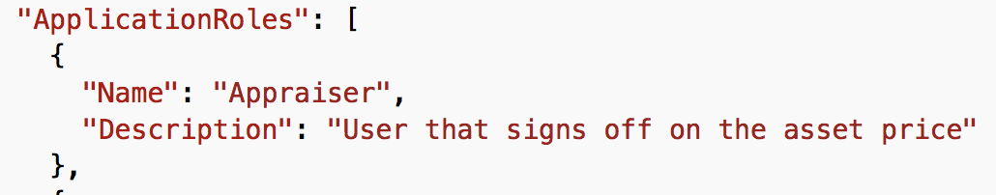
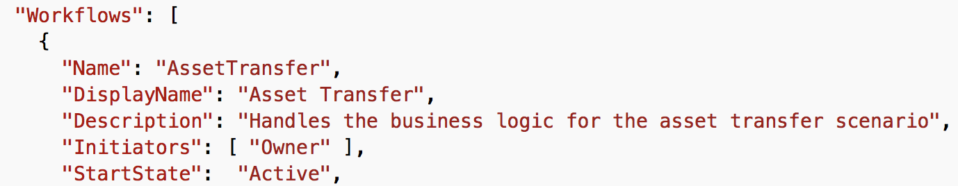
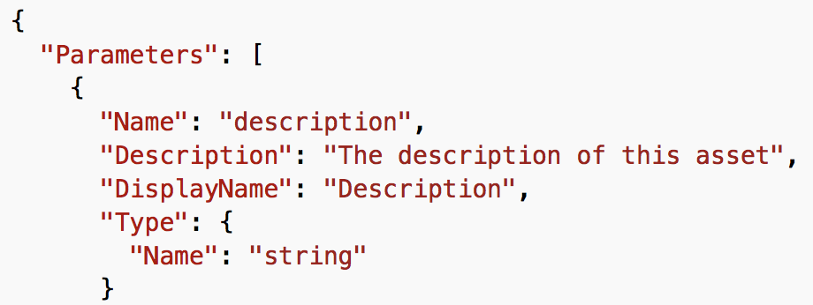
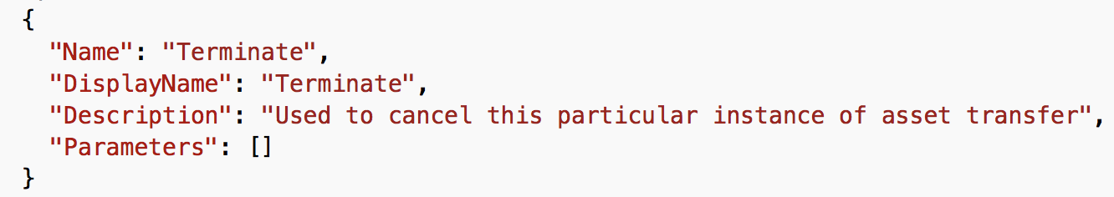
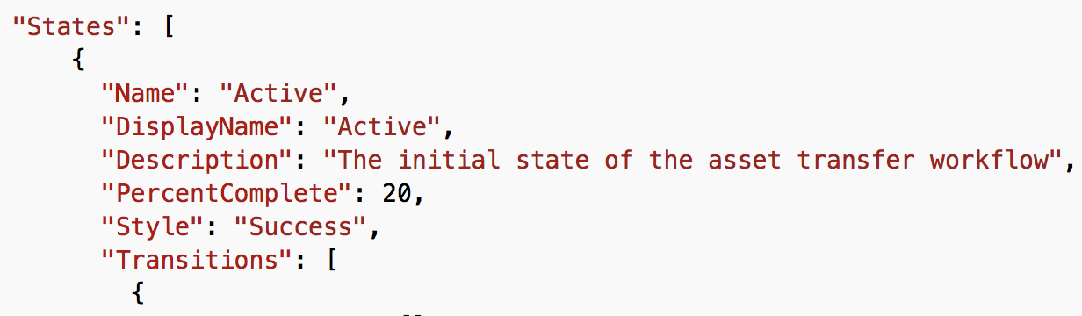
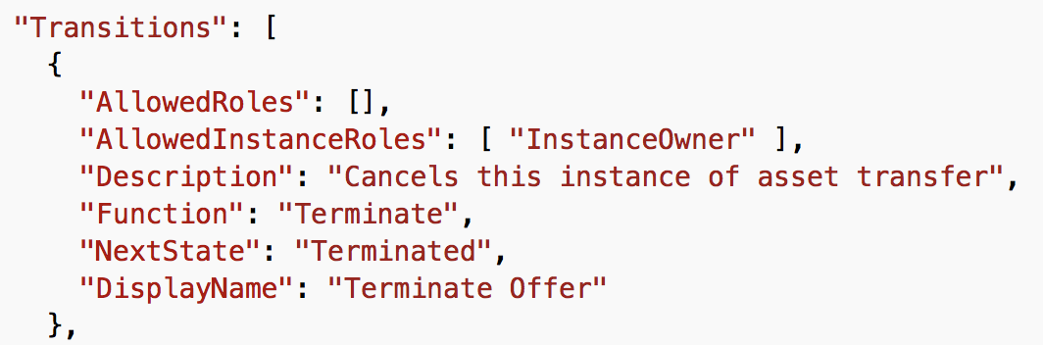
Prepare your Workbench JSON application configuration file
Workflow
Collection of states and actions that models application business logic as a state machine
Constructor
Defines input parameters for an instance of a workflow
Maps to the Parameters column of the chart on the previous slide
Functions
Defines functions that can be executed on the workflow
The corresponding smart contract must use the same Name for the applicable function
States
Transitions
States that define the status within the workflow
Application Roles
Based on Personas
Initiators start the workflow process
Linked to security groups in Azure Active Directory
Participants modify workflow data
Observers have read-only access
Each workflow consists of one or more smart contracts, which represent the business logic in code files.
Maps to the Available Actions on the previous slide
Maps to the current state and target state columns on the previous slide
Available actions to the next state
One or more user roles may perform an action at each state, where an action may transition a state to another state in the workflow
Create JSON configuration file that will contain the following application settings

Slide 24
MVP - Solution Development and Deployment
Group exercise – breaking down an MVP
Individual lab – completing code for the group MVP

Slide 25
Basic Provenance - MVP
The Basic Provenance application expresses a workflow for a simple record of ownership or responsibility.
Basic Provenance starts when an owner wants to tracking ownership or responsibility for an asset. Whenever a new counterparty takes ownership or responsibility of the asset, the owner transfer responsibility to the counterparty. The counterparty can transfer the responsibility to another counterparty, or the owner can decide to complete the transfers of responsibility.

Slide 26
MVP application roles
Name | Description
HINT: Identify each role required to complete the smart contract and what that role is required to do

Slide 27
Enumerate all of your smart contract states
Name | Description
HINT: Contract states are immutable, and it's best to think of states that must be persisted vs. process states that are passing

Slide 28
MVP functions and parameters
Application Role | Available Functions | Parameters
HINT: Use the minimum viable set of parameters to store on your distributed ledger

Slide 29
Prepare to write your workflow details as a Solidity Smart Contract
Workbench uses both the configuration file and smart contract code file to create a blockchain application. There is a relationship between what is defined in the configuration and the code in the smart contract.
The number, order, and type of parameters must match in both files.
Contract
Pass the application name and the workflow name as arguments
1:1 relationship between contracts and config files
Name matching required
State Variables
State variables store values of the state for each contract instance
The state variables in your contract must match the workflow properties defined in the configuration file
Constructor
The constructor defines input parameters for a new smart contract instance of a workflow
The constructor is declared as a function with the same name as the contract
Required parameters for the constructor are defined as constructor parameters in the configuration file
The number, order, and type of parameters must match in both files.
Functions
Functions are the executable units of business logic within a contract
Required parameters for the function are defined as function parameters in the configuration file

Slide 30
Prepare your Workbench JSON application configuration file
Workflow
Collection of states and actions that models application business logic as a state machine
Constructor
Defines input parameters for an instance of a workflow
Maps to the Parameters column of the chart on the previous slide
Functions
Defines functions that can be executed on the workflow
The corresponding smart contract must use the same Name for the applicable function
States
Transitions
States that define the status within the workflow
Application Roles
Based on Personas
Initiators start the workflow process
Linked to security groups in Azure Active Directory
Participants modify workflow data
Observers have read-only access
Each workflow consists of one or more smart contracts, which represent the business logic in code files.
Maps to the Available Actions on the previous slide
Maps to the current state and target state columns on the previous slide
Available actions to the next state
One or more user roles may perform an action at each state, where an action may transition a state to another state in the workflow
Create JSON configuration file that will contain the following application settings
HINT: Use an existing JSON file to guide your implementation

Slide 31
Extending Azure Blockchain Workbench, Architecture
Solutions to extend Azure Blockchain Workbench
API/integration models
GitHub repos, samples, and forums
Open discussion on development, architecture, and platform questions

Slide 32
Closure
Thank you for joining this Blockchain App in a Day workshop!

